Slide 1
Relational Algebra
Database Systems
Note:
Some slides and/or pictures are adapted from Lecture slides / Books of
  Peter Rob
  Jeffery. A. Hoffer
  Thomas M. Connolly
  Ramez Elmasri
  Silberschtaz

Slide 2
Relational Algebra
Relational algebra defines the theoretical way of manipulating table contents using the eight relational operators given as under:
Key operators
  SELECT or RESTRICT
  PROJECT
  PRODUCT
  JOIN
Other operators
  INTERSECT
  UNION
  DIFFERENCE
  DIVIDE

Slide 3
Select
Yields values for all rows found in a table.
Select can be used to either list all or list partial rows values that match a specified criterion (horizontal partitioning).
The select operation is expressed as:
σ_{condition} (relation)
Condition is formed using relation operators and logical operators (AND ^, OR ^{v}, NOT ~)
Example:
The fraction of tuples selected by selection condition is referred to as selectivity of the condition.

Slide 4
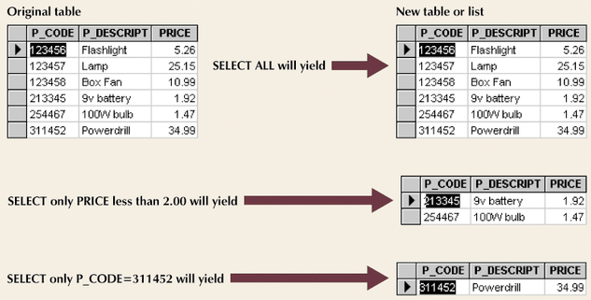
Select
σ_{PRICE < 2} (RODUCT)
σ_{P_CODE = 311452} (RODUCT)

Slide 5
Project
Project yields a vertical subset of a table with selected attributes
The select operation is expressed as:
∏ _{Attributes} (relation)
Example:
Duplicate elimination

Slide 6
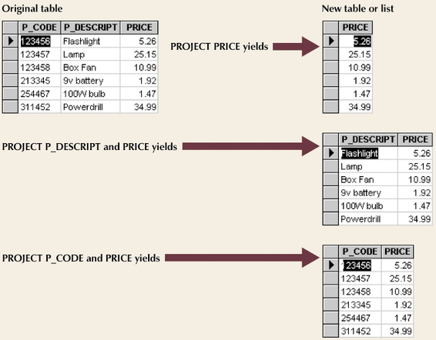
Project
∏_{P_DESCRIPT, PRICE} (PRODUCT)
∏_{P_CODE, PRICE} (PRODUCT)

Slide 7
Select + Project
Suppose we want to perform the following operations together:
It can be done in the following ways:
OR
Rename
ρS(B1, B2, ... , Bn)(R) or ρS(R) or ρ(B1, B2, ... , Bn)(R)
Where S and Bi are new names of relation/attributes
σ_{PRICE < 2} (PRODUCT)
∏_{P_DESCRIPT, PRICE} (PRODUCT)
∏_{P_DESCRIPT, PRICE} (σ_{PRICE < 2} (PRODUCT))
PROD-TEMP ← σ_{PRICE < 2} (PRODUCT)
∏_{P_DESCRIPT, PRICE} (PROD-TEMP)

Slide 8
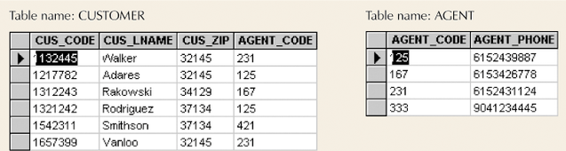
(Cartesian) Product or Cross Join
Product operation combines all tuple of the first table all the tuples of the second table
R x S
Example:

Slide 9
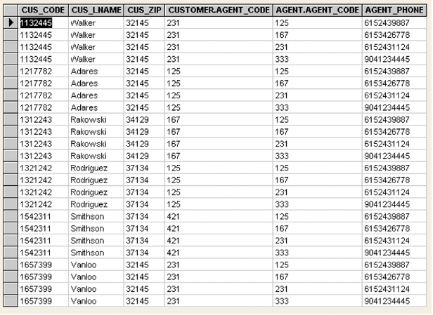
(Cartesian) Product

Slide 10
Join
Combine information from multiple tables that are logically related with each other (usually a referencing and a referenced table) such that each tuple pair satisfy some condition. (e.g., equal values in a given col.)
(Natural
or Inner)
Join
A1 B1 C1
A2 B1 C1
A3 B2 C2
A1 B1
A2 B1
A3 B2
B1 C1
B2 C2
B3 C3

Slide 11
Join
A join operation includes the following operations:
  Product creates one table
  Select yields appropriate rows
  Project yields single copy of each attribute to eliminate duplicate columns
There are the following types of join
  Natural Join or equiJoin
    The common attribute is repeated in equijoin and natural join was introduced to get rid of the repeating attribute
  Theta Join
  Outer Join
σ_{R.A = S.A} (R x S)
R S

Slide 12
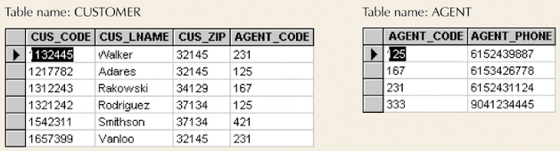
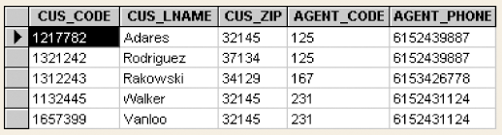
Join

Slide 13
Join Types
Equi Join links tables by selecting rows with common values in common attribute(s)
Theta Join: EquiJOIN that compares specified columns of each table using any general Boolean expression
Outer JOIN
  Matched pairs are retained
  Unmatched values in other tables left null
  Right and left outer JOIN

Slide 14
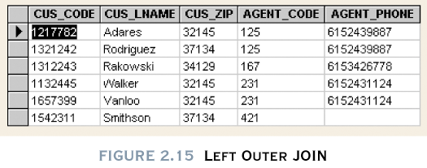

Slide 15
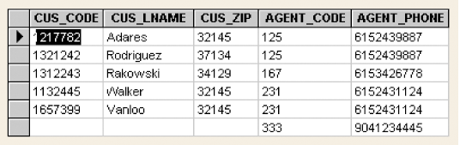

Slide 16
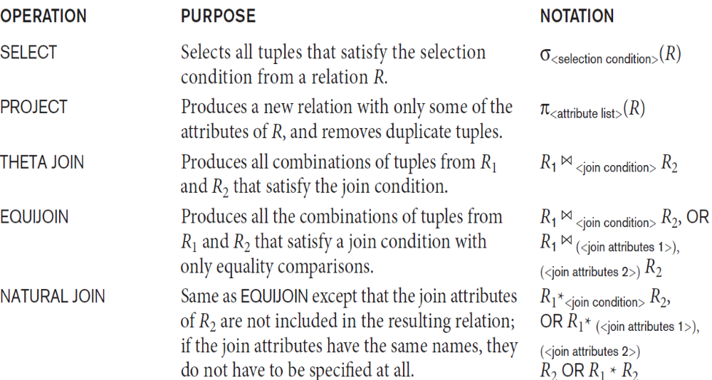

Summary

Slide 17
UNION
Tables must have the same attribute characters (column and domains must be identical)
That is called these tables are UNION compatible
Combines all rows
Example:

Slide 18
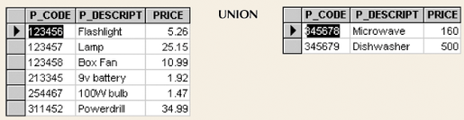
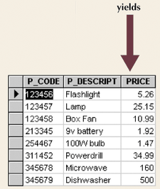
Union

Slide 19
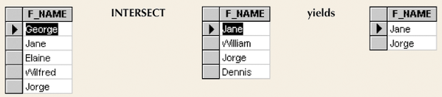
Intersect
Yields rows that appear in both tables

Slide 20
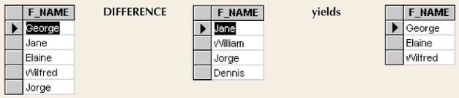
Difference
Yields rows not found in other tables

Slide 21
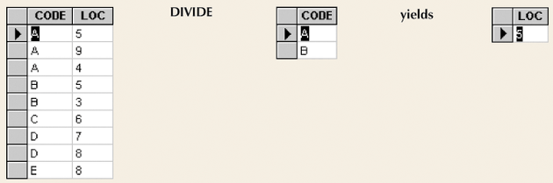
Divide
Requires one single-column table and one two-column table

Slide 22
Thank you for your attention.
Reading Material
Book section 3-4
Asif Sohail
Assistant Professor
University of the Punjab
Punjab University College of Information Technology (PUCIT)
Allama Iqbal (Old) Campus, Anarkali
Lahore, Pakistan
Tel: +92-(0)42-111-923-923 Ext. 154
E-mail: asif@pucit.edu.pk

